Slide 1

KGiSL INSTITUTE OF TECHNOLOGY
COIMBATORE
DEPARTMENT OF computer science & engineering
Project phase FINAL review
TEXT, IMAGE AND AUDIO STEGANOGRAPHY
Team Members:
711719104054 Nandika L R
711719104094 Sneha C I
711719104102 Timothy Jerald Xavier
711719104103 Treesa Mary George
Under the guidance of :
Ms. Aruna T N , Asst. Professor, CSE.

Slide 2

agenda
Abstract
Existing System
Literature Survey
Proposed System
Architectural Diagram
Module Splitup
Expected Outcome
Screenshots
Reference
Timeline

Slide 3
abstract
Steganography refers to the concealment of confidential data within a common medium, like a text, image, or audio file, without altering its original appearance, in order to evade detection. This method is used for several purposes, including protecting data privacy, preventing unauthorized access to data, and ensuring safe information transmission over insecure networks. While steganography can be used for legitimate purposes such as by military, law enforcement, and journalism, it can also be employed for malicious activities like cybercrime and terrorism. The least significant bit (LSB) of each letter in text & audio and the LSB of each pixel in images are altered in steganography to make the alterations invisible. Advanced steganography algorithms like Masking & Filtering and Encrypt & Scatter have improved security against steganalysis assaults while producing higher-quality stego images. The method’s capability for concealing text with an unlimited hidden text size in text, audio, and images will be employed in the outcome.

Slide 4
EXISTING SYSTEM
The existing system consists of traditional steganography techniques that use the LSB method to embed secret messages in text, audio, and images.
The existing system includes the encryption of the hidden message, before embedding it to the cover image or text or audio to enhance the security in the steganography.
DRAWBACKS
The traditional LSB method is vulnerable to steganalysis attacks, which can be used to detect the presence of hidden information.
The amount of text that can be embedded is limited by the capacity of the text, audio, and image, which is determined by factors such as size and resolution.

Slide 5
LITERATURE SURVEY
TITLE | PUBLICATION YEAR | AUTHOR | DESCRIPTION
A Review Paper on Text steganography | 2022 | Samruddhi Deshmukh, Mitalee Manware, Radhika Chhablani, Shweta Meshram | Provides the study of various techniques on text steganography and improvement in each method is described
Image Steganography using Least Significant Bit (LSB) - A Systematic Literature Review | 2022 | Muhammad Adnan Aslam, Muhammad Rashid, Farooque Azam, Muhammad Abbas, Yawar Rasheed, Saud S. Alotaibi, Muhammad Waseem Anwar | The Least Significant Bit (LSB) in the last bit of each pixel is modified and replaced with the secret message’s data bit.
Steganography Techniques - An Overview | 2022 | Amitava Podder, Piyal Roy, Smaranika Roy | Steganography is an intriguing and successful method of data hiding that has been utilized for centuries. This type of data hiding is also used for many legitimate reasons, such as secured storage techniques.
A Survey of Text Steganography Methods | 2021 | Vivek Sharma S, Monika Raj, Swathi S | Text steganography is the most difficult kind of steganography because a text file lacks a large-scale redundancy of information in comparison to other digital medium like image, audio and video.
Modified LSB on Audio Steganography using WAV Format | 2021 | Rini Indrayani | Steganography on the WAV format audio cover media using the methods of LSB, LSB + 1, LSB + 2, LSB + 3, LSB + 4, LSB + 5, LSB + 6, and LSB + 7 has been successfully carried out with various evaluations.

Slide 6
LITERATURE SURVEY
TITLE | PUBLICATION YEAR | AUTHOR | DESCRIPTION
Information Hiding in Audio Steganography using LSB Matching Revisited | 2021 | R Shanthakumari, E M Roopa Devi, R Rajadevi, B Bharaneeshwar | Audio steganography scheme based on LSB matching revisited algorithm is applied to embed concealed information into audio without inventing perceptible distortions.
Image Steganography: A Review of the Recent Advances | 2021 | Nandhini Subramanian, Omar Elharrouss, Somaya Al-Maadeed, Ahmed Bouridane | The secret data is converted into binary bits and the cover image is manipulated statistically to embed the secret binary bits.
Securing Technique Using Pattern-Based LSB AudioSteganography and Intensity-Based Visual Cryptography | 2020 | Pranati Rakshit, Sreeparna Ganguly, Souvik Pal, Ayman A. Aly, Dac-Nhuong Le | An intensity-based visual cryptography scheme is used along with an additional layer of audio steganography in the time domain. Here, the intensity of the secret image pixel is distributed among several basis matrices
Development of an Audio Steganography System Using Discrete Cosine Transform and Spread Spectrum Techniques | 2020 | Olawale Timothy Adeboje, Arome Junior Gabriel, Adebayo Olusola Adetunmbi | Development of an efficient and robust audio steganography system for the security of information
A Study and Literature Review on Various Image Steganography Techniques | 2020 | Sonali K. Powar, H.T. Dinde, Radhika.M. Patil | Contains different steganography techniques used to transmit secret information securely through the internet.

Slide 7
PROPOSED SYSTEM
The proposed technique focuses on embedding secret messages in realistic images using masking & filtering and Encrypt & scatter.
The proposed system prioritizes providing secure communication, digital watermarking, and copyright protection to effectuate Steganography.
ADVANTAGES
The model utilizes masking & filtering and Encrypt & scatter to embed a large amount of data in the image while maintaining the image's quality.
This secured system is highly robust against steganalysis attacks and provides high-quality stego text, audio, and images.

Slide 8
Architectural diagram
Secret Message
ENCODING
Encryption
Stego Text/ Audio/ Image
USER
Cover Text/ Audio/ Image
Secret Message
DECODING
Stego Text/ Audio/ Image
Encryption
Cover Text/ Audio/ Image

Slide 9
Module split up
Module 1 | Text Steganography
Module 2 | Audio Steganography
Module 3 | Image Steganography
Module 4 | Masking and Filtering

Slide 10
EXPECTED OUTCOME
The expected outcome of embedding secret messages in realistic texts, audio, and images is that the messages will be well hidden and difficult to detect by unauthorized parties while being easily retrievable by the intended recipient.
The capacity of advanced algorithms to embed large amounts of data in the text, audio, or image while maintaining the file’s quality can also allow for more information to be transmitted within a single text document, audio, and image file.
In total, Steganography provides a secure and reliable way to transmit sensitive information while maintaining the integrity of the message passed.

Slide 11


Screenshots

Slide 12


Screenshots

Slide 13


Screenshots

Slide 14
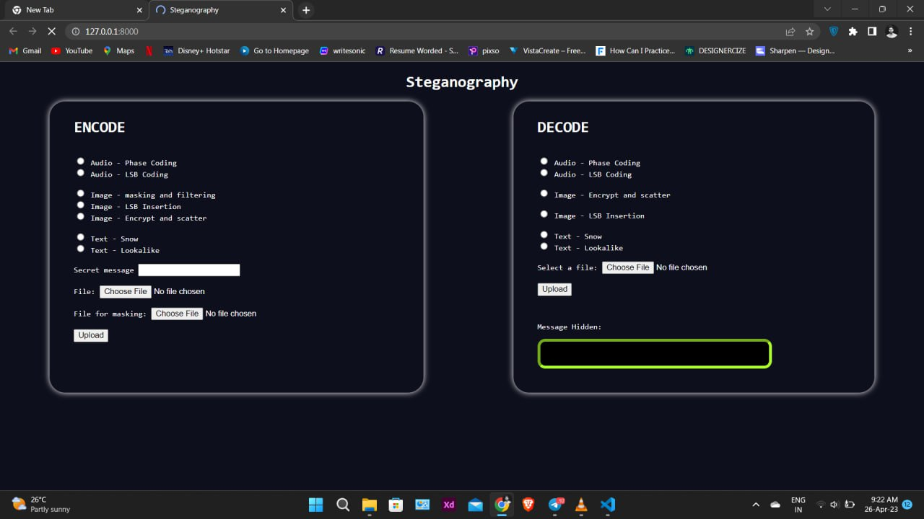
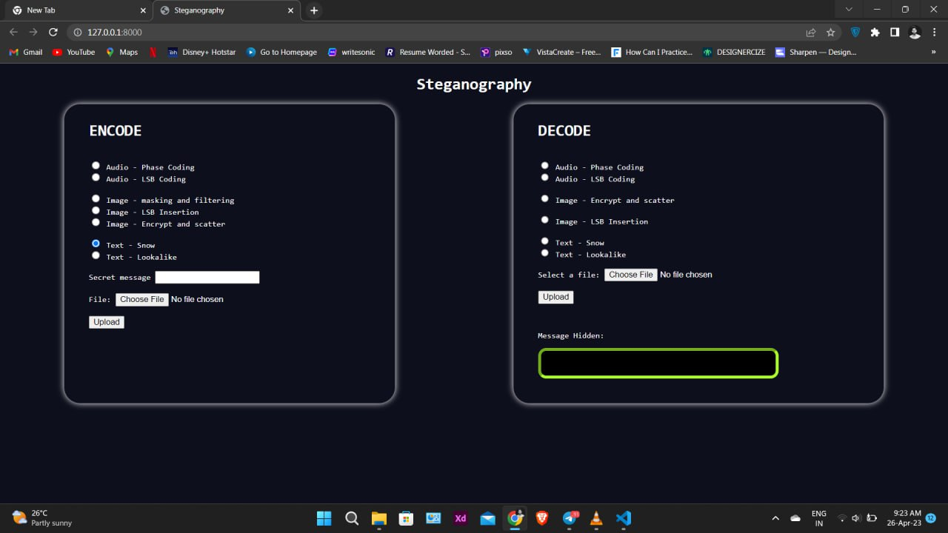
Screenshots

Slide 15
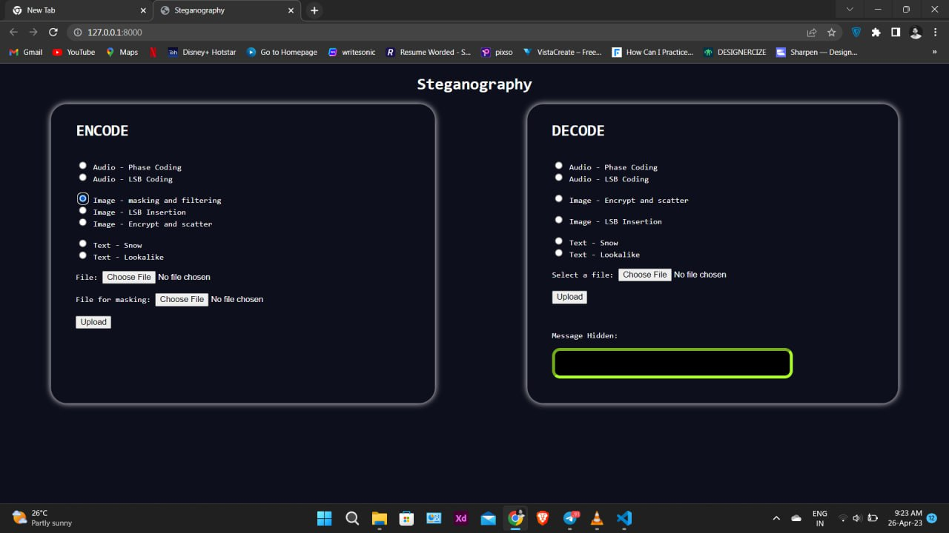
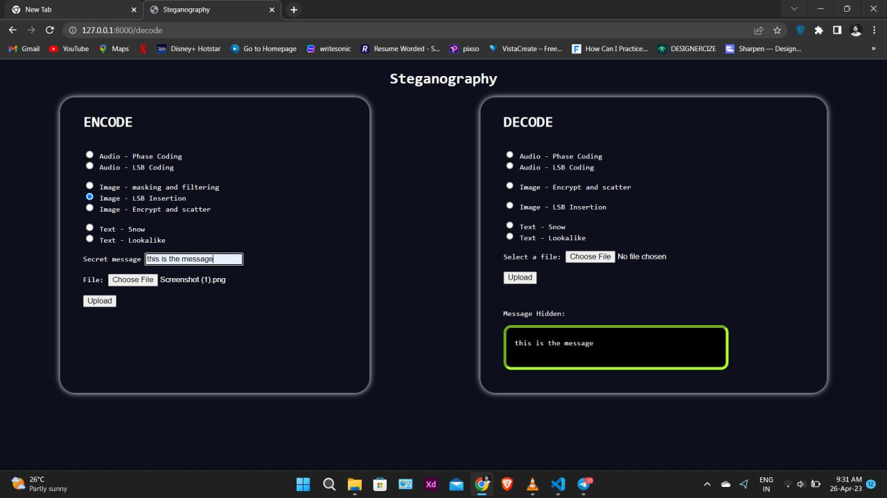
Screenshots

Slide 16
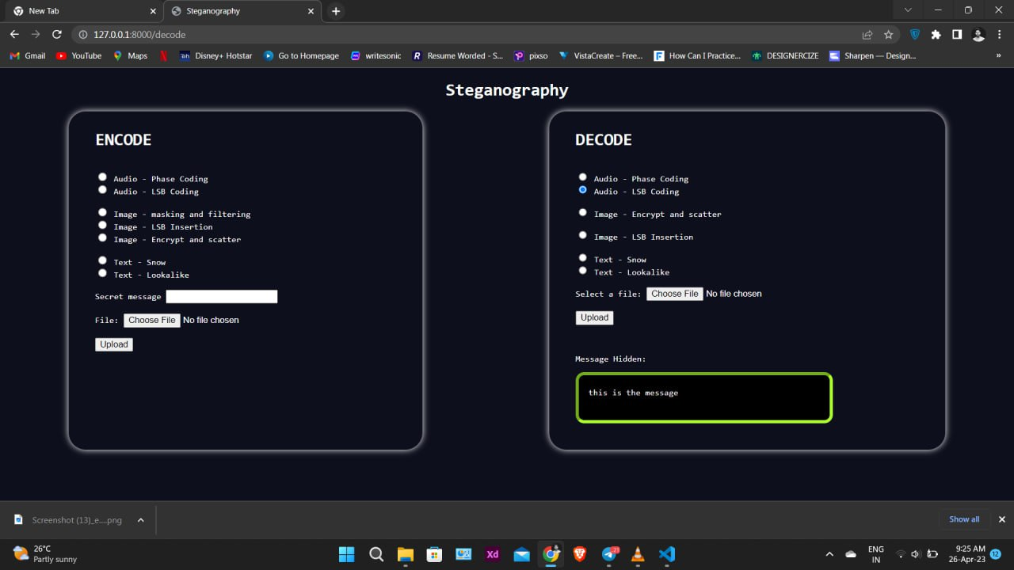
Screenshots

Slide 17
REFERENCE
[1] Samruddhi Deshmukh, Mitalee Manware, Radhika Chhablani, Shweta Meshram (A Review Paper on Text steganography - July 2022 International Journal of Research in Engineering and Science)
[2] Muhammad Adnan Aslam, Muhammad Rashid, Farooque Azam, Muhammad Abbas, Yawar Rasheed, Saud S. Alotaibi, Muhammad Waseem Anwar (Image Steganography using Least Significant Bit (LSB) - A Systematic Literature Review - January 2022 2nd International Conference on Computing and Information Technology)
[3] Amitava Podder, Piyal Roy, Smaranika Roy (Steganography Techniques - An Overview - November 2022 International Journal of Scientific Research in Computer Science Engineering and Information Technology)
[4] Vivek Sharma S, Monika Raj, Swathi S (A Survey of Text Steganography Methods - May 2021 International Journal of Scientific Research in Science and Technology)
[5] Rini Indrayani (Modified LSB on Audio Steganography using WAV Format - January 2021 3rd International Conference on Information and Communications Technology)

Slide 18
REFERENCE
[6] R Shanthakumari, E M Roopa Devi, R Rajadevi, B Bharaneeshwar (Information Hiding in Audio Steganography using LSB Matching Revisited - May 2021 Journal of Physics Conference Series)
[7] Nandhini Subramanian, Omar Elharrouss, Somaya Al-Maadeed, Ahmed Bouridane (Image Steganography: A Review of the Recent Advances - January 2021 IEEE)
[8] Pranati Rakshit, Sreeparna Ganguly, Souvik Pal, Ayman A. Aly, Dac-Nhuong Le (Securing Technique Using Pattern-Based LSB AudioSteganography and Intensity-Based Visual Cryptography - November 2020 Computers, Materials and Continua 67(1):1207-1224)
[9] Olawale Timothy Adeboje, Arome Junior Gabriel, Adebayo Olusola Adetunmbi (Development of an Audio Steganography System Using Discrete Cosine Transform and Spread Spectrum Techniques - September 2020 International Conference on Computational Science and Its Applications)
[10] Sonali K. Powar, H.T. Dinde, Radhika.M. Patil (A Study and Literature Review on Various Image Steganography Techniques - August 2020 International Research Journal of Engineering and Technology)

Slide 19
TIMELINE
Particulars | Feb-23 |  |  |  | Mar-23 |  |  |  | Apr-23 |  |  |  | May-22
 | Wk1 | Wk2 | Wk3 | Wk4 | Wk1 | Wk2 | Wk3 | Wk4 | Wk1 | Wk2 | Wk3 | Wk4 | Wk1 | Wk2 | Wk3 | Wk4
Problem Identification
Literature Survey
Module 1
Module 2
Module 3
Testing
Thesis Draft
Final Thesis
Viva

Slide 20
THANK YOU

